Slide 1

Project Architecture
Web Applications Designs and Architectures, Repository Pattern, Automapper, Databases and ORM
SoftUni Team
Technical Trainers
Software University
https://softuni.bg

Slide 2
Table of Contents
Web Application Designs
Multi-Page applications vs SPA
Web Application Architectures
Monolith vs SOA vs Microservices
ASP.NET Core MVC vs Razor Pages
Repository Pattern
AutoMapper
Databases & ORMs
ORM vs Micro-ORM
SQL vs NoSQL

Slide 3
Have a Question?
sli.do #csharp-web

Slide 4

Web Application Designs

Slide 5
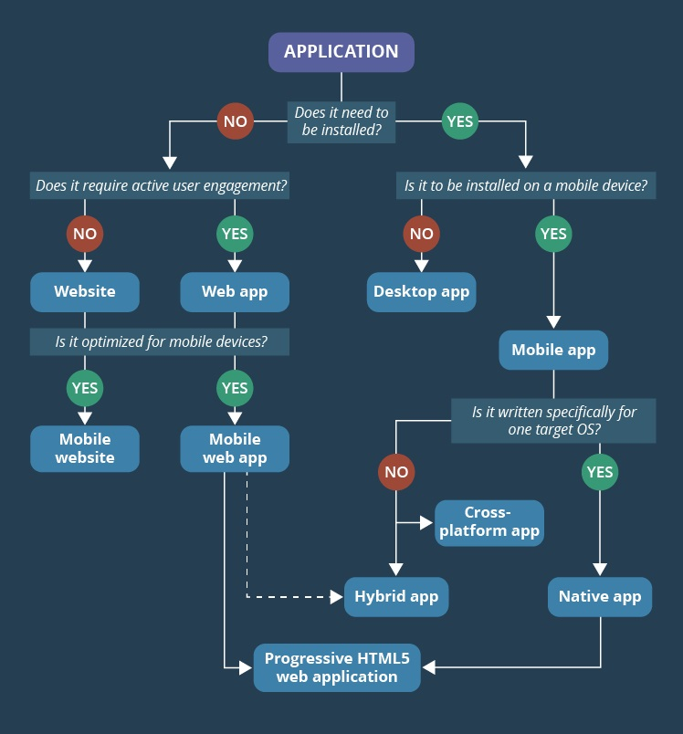
Web vs Desktop vs Mobile vs IoT
Desktop Application
PRO: Can work offline, Has access to system resources
CON: Needs to be installed (updated) on each computer
Mobile Application
PRO: App stores, Offline, Access to system resources
CON: Different platforms, Each update requires approval
Web Application
PRO: No need to be downloaded, installed or updated
CON: Require Internet, Limited system access
Internet-of-Things Application
Smart home, wearables, cars, farming, cities, etc.
They require web access to send their data

Slide 6
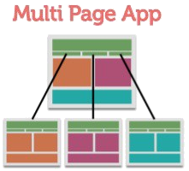

Web Application Designs
Web applications are easy to install, use, update and are not bound to one device
In most cases, they are the preferable over desktop apps
There are 2 participants in the web applications – client and server
There are two main designs for web apps:
Multi-Page application (MPA) – the "traditional" approach
Single-Page application (SPA) – the "modern" approach

Slide 7
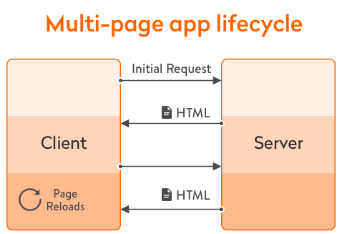
Multi-Page Applications (1)
Multi-Page applications work in a "traditional" way
Every change requests rendering of a new page in the browser
Perform most of the application logic on the server
HTML is rendered on the server and returned as HTTP Response
AJAX and JavaScript may be used to add UI logic on the client
ASP.NET Core MVC and Razor Pages implement this approach

Slide 8
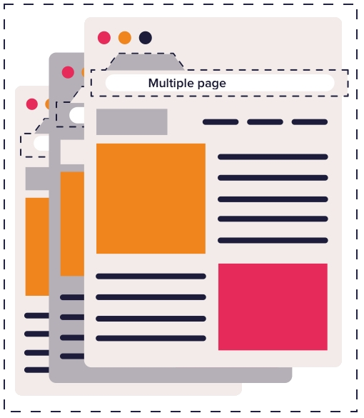
Multi-Page Applications (2)
PROs of Multi-Page applications
Useful for every type of projects
Very good and easy for proper SEO management
Using consistent languages, tools and technologies
CONs of Multi-Page applications
Front-end and back-end are tightly coupled
The development and maintenance is quite complex
Requires page (state) reload on user action (link, form submit)

Slide 9
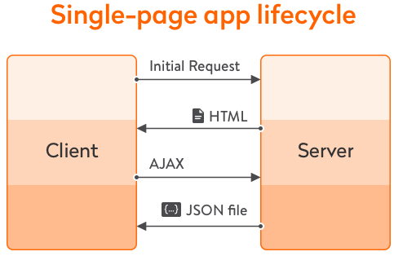
Single-Page Applications (1)
Single-Page applications perform most of the UI in the browser
Does not require page reload during use
The whole app is in one page – content is changed dynamically
Examples: Gmail, Facebook, Instagram etc.
SPA requests logic (JS, templates) and data independently
Back-end: ASP.NET Core Web API returning JSON data
Frond-end: Angular, React, Vue.js, Blazor, etc.

Slide 10

Single-Page Applications (2)
PROs of Single-Page applications
Animated, east-to-navigate and more user-friendly
SPAs are fast, most resources are loaded only once
Easy to make a corresponding mobile application
Reusing the same Back-End
CONs of Single-Page applications
Quite tricky, and not easy to make SEO of the app
Slow to download, because of heavy front-end frameworks
Compared to "traditional" apps, SPAs are less secure
In most cases, require the use of 2 completely different technologies

Slide 11

Web Application Architectures

Slide 12
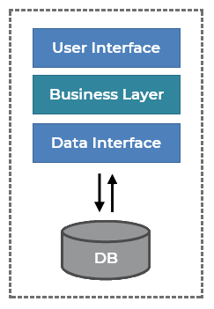
Monolithic Applications
Monolithic applications are single-tiered applications
User interface and data access code are combined
The simplest form of architecture
Deployment and maintenance is quite easy
Achieved due to lack of modularity and complexity
Monolithic apps are recommended for small and mid-sized projects
Where the scope of functionality does not require abstractions
In most cases, monolith apps are not desired

Slide 13
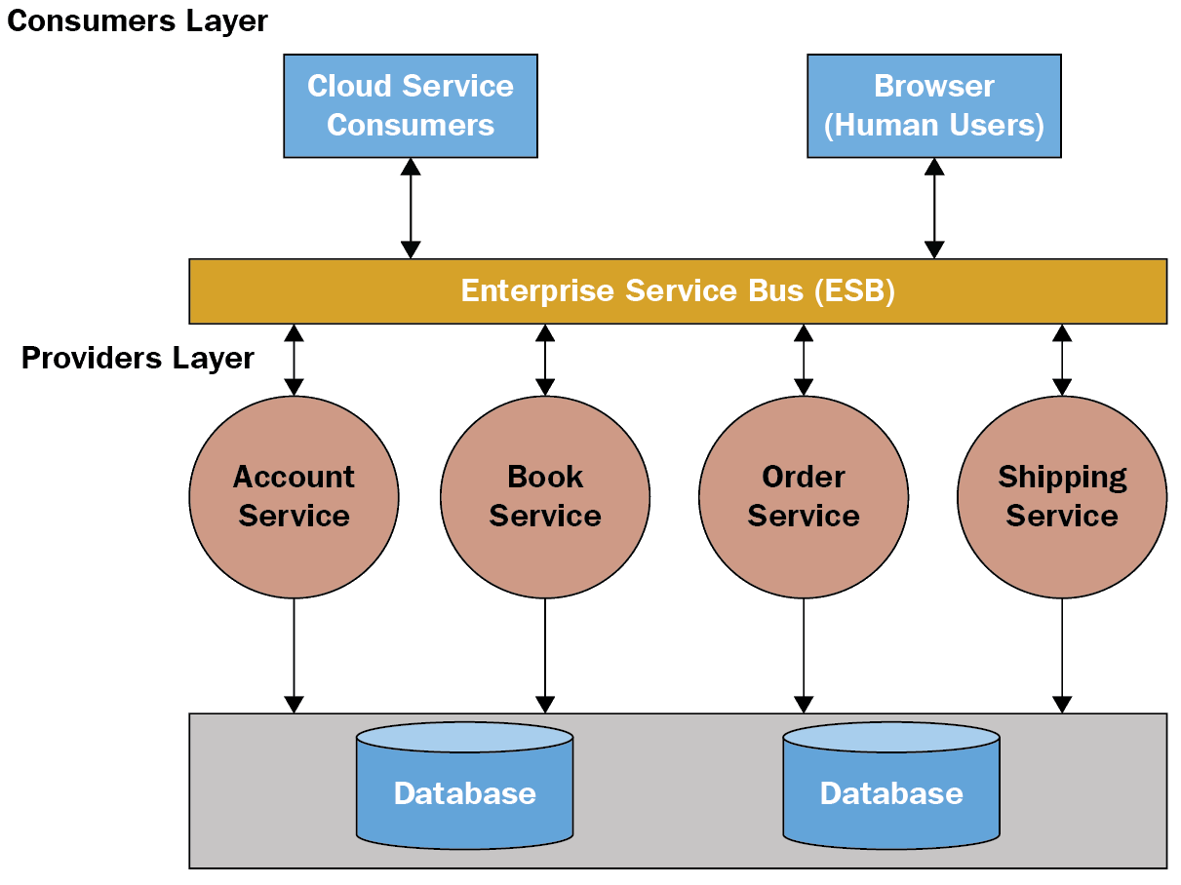
Service-Oriented Architectures (SOA)
Service-Oriented Architectures (SOA)
Usually incorporate functions into smaller apps (services)
Communication is established over SOAP/XML, WS
Services communicate using Enterprise Service Bus
Services do multiple activities over a single scope of functionality
All services share the same data store

Slide 14
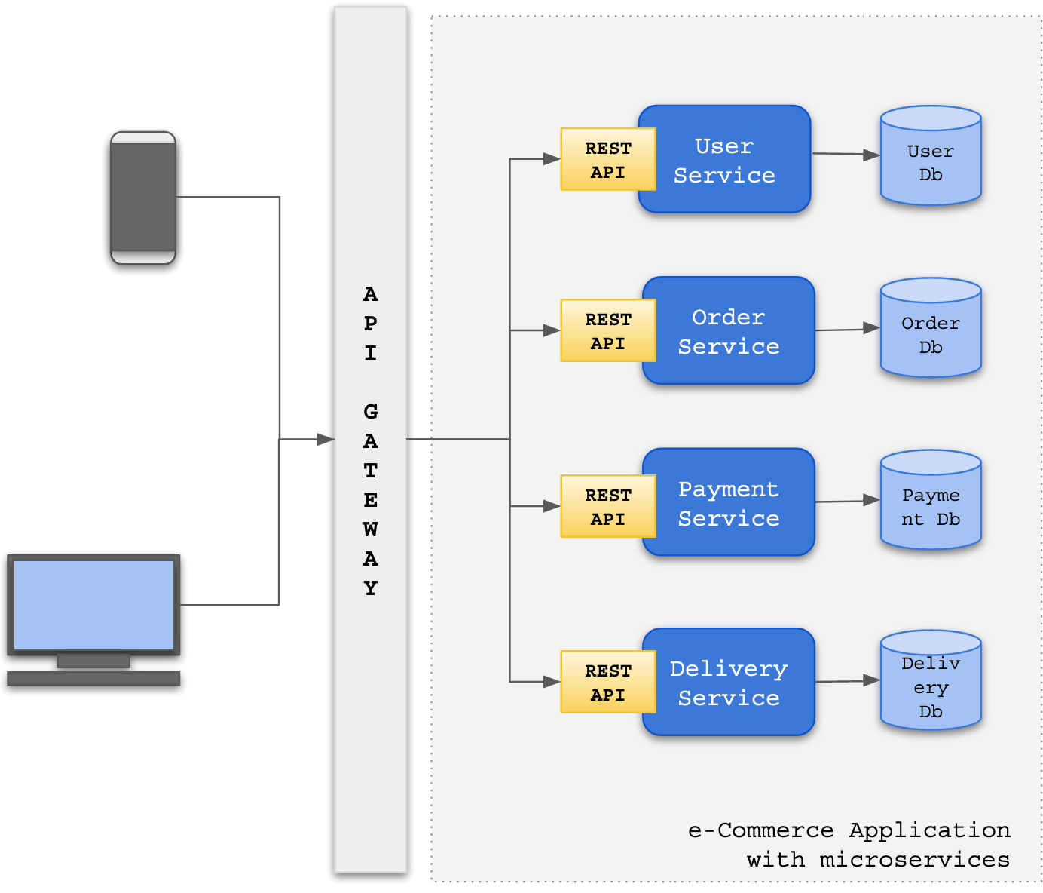
Microservices
Microservices is an architecture based on lots of small applications
Collection of loosely coupled services
The size should be minimal
Enables continuous deployment
Can be deployed independently
All services communicate directly
Every service has its own store
Communication: REST, Web API, HTTP

Slide 15
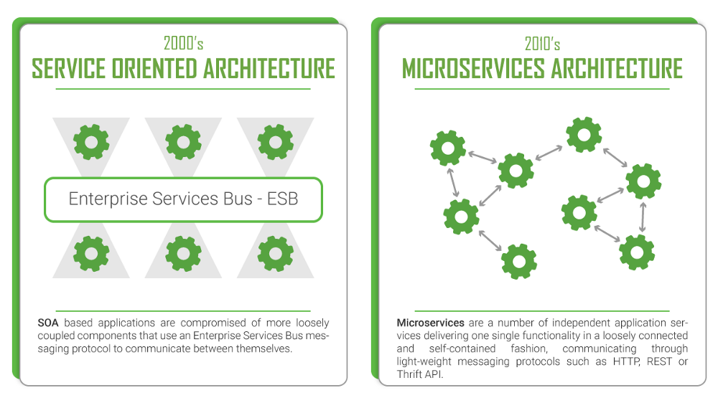
SOA vs Microservices

Slide 16
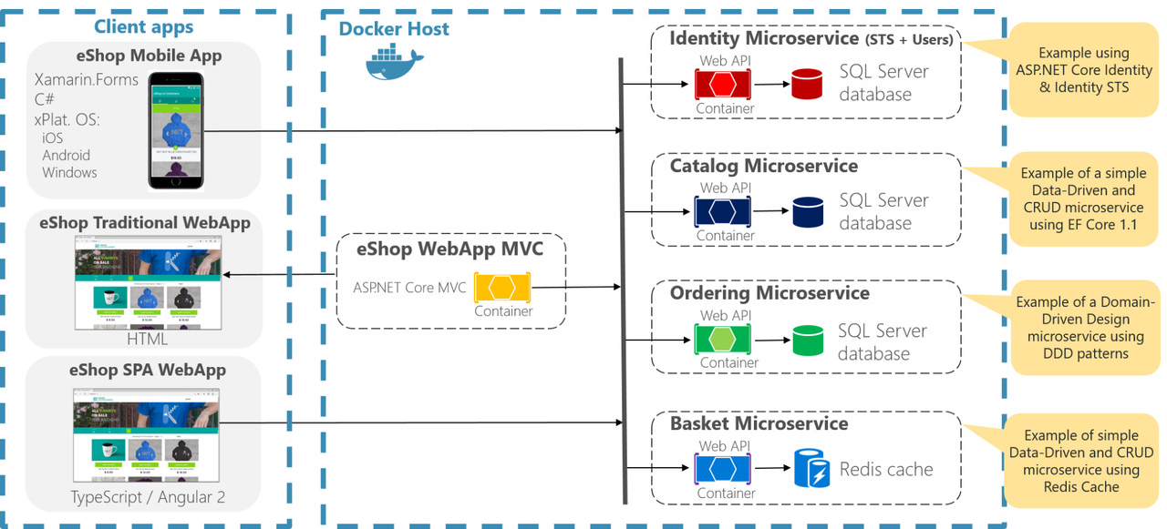
Example Microservices App

Slide 17

ASP.NET Core MVC vs Razor Pages

Slide 18
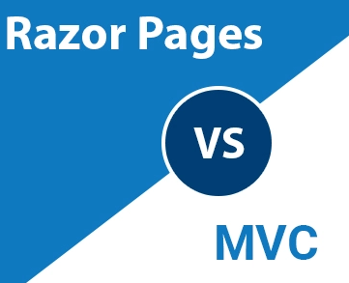
ASP.NET Core MVC vs Razor Pages
Apart from MVC, ASP.NET Core provides another approach
Enter Razor Pages! A Model-View-ViewModel-like framework
Razor Pages are similar to View Components
Model & Controller code is included in the Page itself
Enables two-way data binding and simpler development
Perfect for simple applications
With read-only functionality or simple data input
The single responsibility is strong

Slide 19
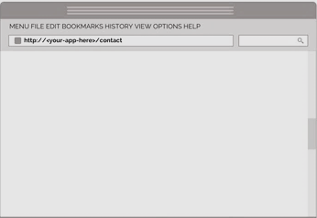
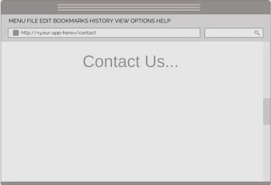


The MVC Approach (1)
Request
Render View
UsersController
Views\Users
Users/Index
GET- Index
ASP.NET Routing
ASP.NET ViewEngine
ASP.NET routes request to controllers action
Users/Profile
GET - Profile
Controller/Action

Slide 20
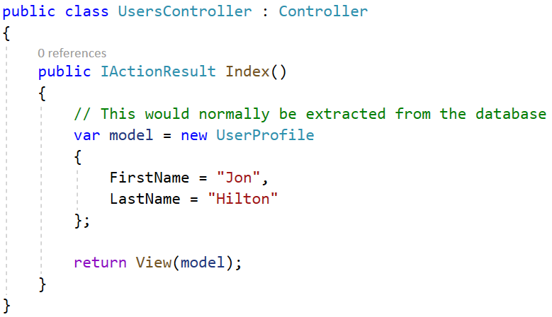
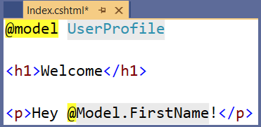
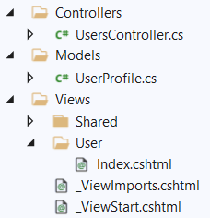
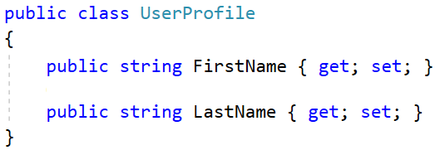
The MVC Approach (2)

Slide 21
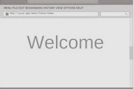

The Razor Pages Approach (1)
Request
Render View
Users Folder
Users/Index
Index.cshtml
Index.cshtml.cs
ASP.NET Routing
ASP.NET ViewEngine
ASP.NET routes request to razor page
Users/Profile
Profile.cshtml
Razor Pages (acts as a action)
Profile.cshtml.cs

Slide 22
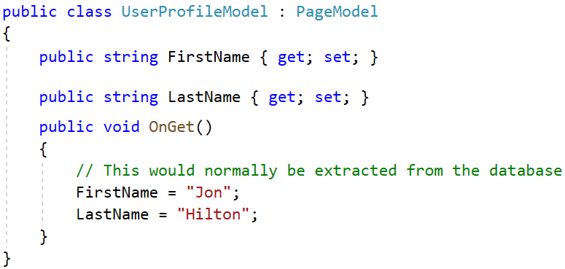

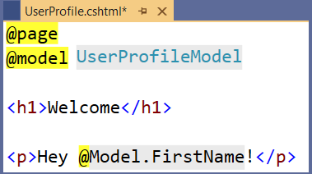
The Razor Pages Approach (2)
Every Razor Page consists of:
A view template (.cshtml), which acts as a view
A functional (.cs) file, which acts as its model + controller action

Slide 23

AutoMapper

Slide 24

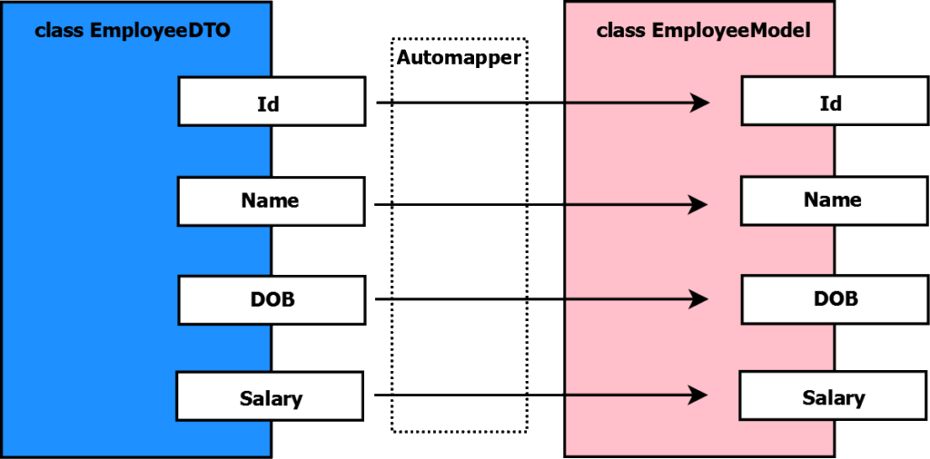
AutoMapper
AutoMapper is a library built to simplify object mapping
Easily imported in ASP.NET Core
Added as a dependency to the DI
Gets rid of ugly property setters
Easy to use in code
Highly flexible
Easily configurable
Used in millions of projects

Slide 25


AutoMapper Setting
Setting up the AutoMapper in your ASP.NET Core project
This will also install the main AutoMapper NuGet package
Registering AutoMapper as a dependency in the DI
Install-Package AutoMapper.Extensions.Microsoft.DependencyInjection
builder.Services.AddAutoMapper(typeof(Program));
public class HomeController : Controller
{
private readonly IMapper mapper;
public HomeController(IMapper mapper)
{
this.mapper = mapper;
}
...
}

Slide 26
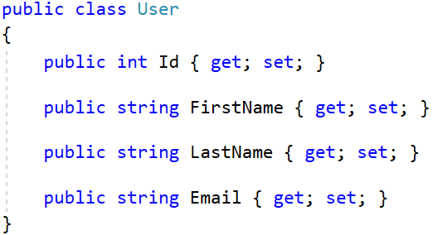
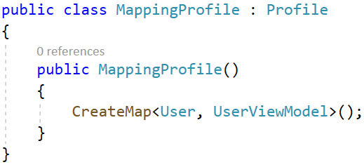
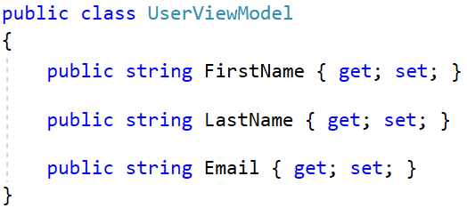
AutoMapper Mapping
Using the AutoMapper in your ASP.NET Core project
The mapping class should inherit Profile
Create the mapping between User and UserViewModel

Slide 27
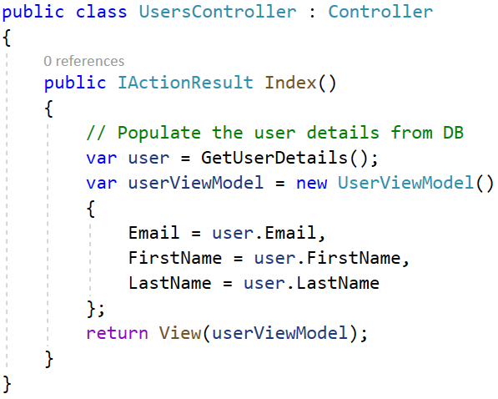
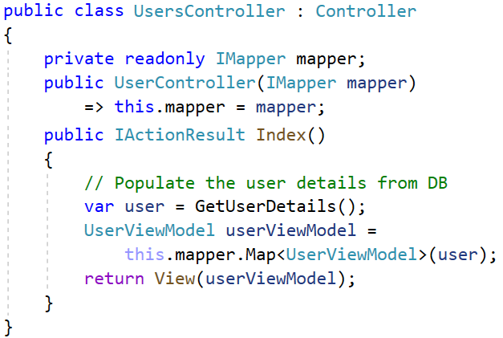
AutoMapper (Business Logic)
Without AutoMapper
With AutoMapper
Clean, beautiful, simple
Commonly-syntaxed
Ugly, mistake-prone, unreadable
Easily modifiable

Slide 28
Abstracting the Data Access Logic
Repository Pattern

Slide 29
Repository Pattern (1)
Repositories are components that encapsulate data access logic
They centralize common data access functionality
They provide better maintainability and testability
They decouple the data access infrastructure from the Domain layer
For each aggregate, you should define one Repository
Repositories, basically, allow you to populate data in-memory
Data is mapped from database to Domain Entities
Once in-memory, entities can be changed and persisted back

Slide 30


Repository Pattern (2)
Normally you implement specific Interface-Class pairs.
There are other ways, though. Like Generic Repositories, for example
public interface IRepository<TEntity>
{
IQueryable<TEntity> All();
void Add(TEntity entity);
void Update(TEntity entity);
void Delete(TEntity entity);
Task<int> SaveChangesAsync();
}
public class EfRepository<TEntity> : IRepository<TEntity>
{
private ApplicationContext context;
private DbSet<TEntity> dbSet;
public StudentRepository(ApplicationContext context)
{
this.context = context;
this.dbSet = this.Context.Set<TEntity>();
}
public IQueryable<TEntity> All() => this.DbSet;
public void Add(TEntity entity) => this.DbSet.Add(entity);
public void Update(TEntity entity) { ... }
public void Delete(TEntity entity) { ... }
public Task<int> SaveChangesAsync() { ... }
}

Slide 31

Databases & ORMs

Slide 32

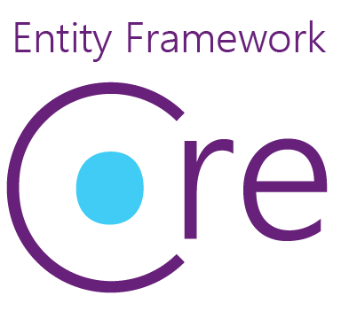
Object Relational Mapper (ORM)
Entity Framework Core is an Object Relational Mapper (ORM)
Creates a layer between your applications and data source
Maps the data to relational objects
EF Core has a lot of essential and convenient features
Generates complex, optimized queries for your convenience
Translated from LINQ expression and cached
Manages the unit of work for you
Tracks changes in the Entities

Slide 33


Dapper
But EF Core pays a cost for all of its features...
And that cost is performance
But there must be a faster alternative
Enter Dapper! The Open-source Micro ORM
A lightweight micro ORM, and a very fast performing one
Dapper is "Closer to the metal"
Complex querying might be exceptionally hard
Not suited for lazy developers

Slide 34
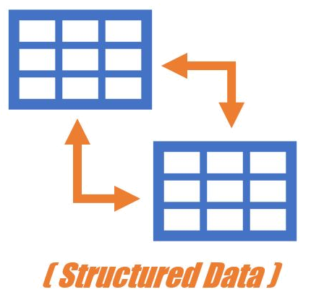
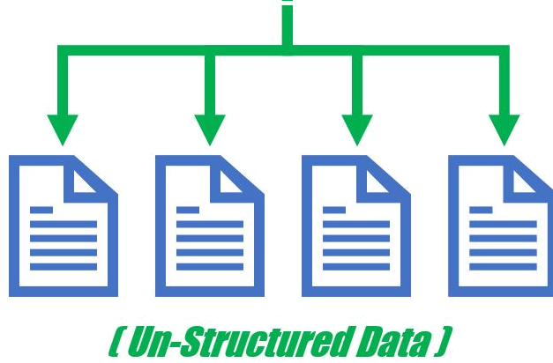
Databases
Developing an application requires the choice of a database
One of the most important decisions in the development
Two choices: relational (SQL) or non-relational (NoSQL) data structure
SQL databases use Structured Query Language (SQL)
Data definition, Data manipulation, Querying, Programmability etc.
NoSQL databases use dynamic schema for unstructured data
Data can be stored as Columns, Documents, Graphs, Key-Value pairs

Slide 35
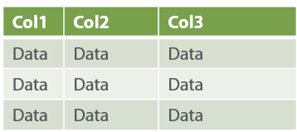
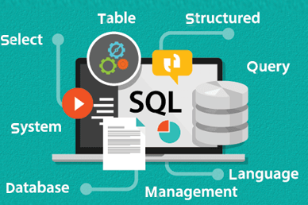
SQL
SQL is extremely powerful, versatile, widely used
A safe choice, especially for complex querying
Very fast performing, even with large sets of data
On the other hand, SQL can be restrictive
Predefined schemas are required to determine the data structure
All of the data must follow that predefined data structure
This requires significant up-front preparation and planning

Slide 36
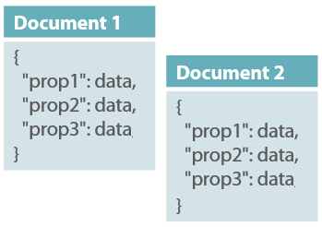
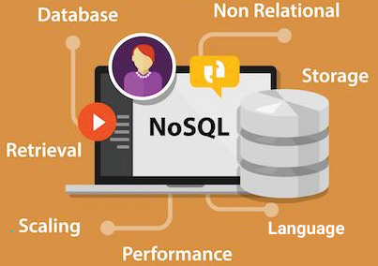
NoSQL
NoSQL databases have their advantages and disadvantages too
You can create documents without pre-defining their structure
Each document can have its own unique structure
You can add fields on the go
The drawbacks are also important to be noted
Lack of standardization
Lack of data consistency

Slide 37


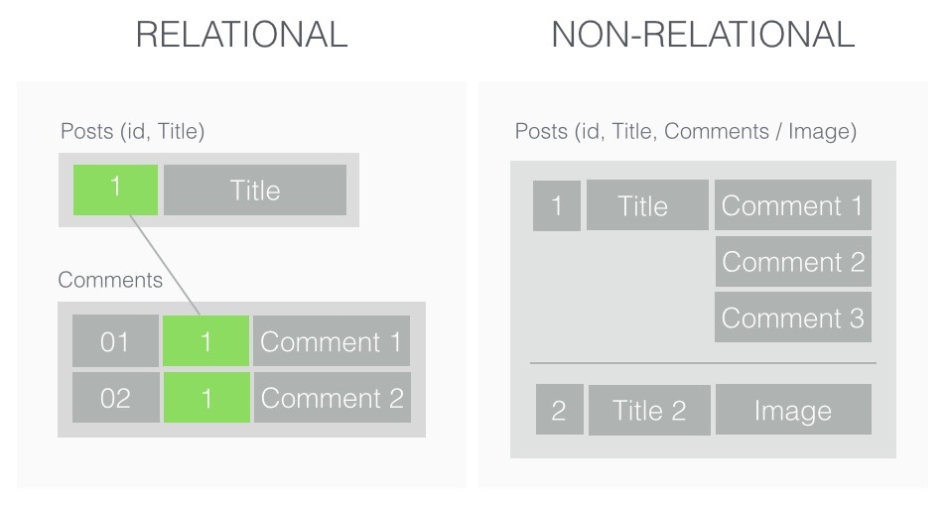


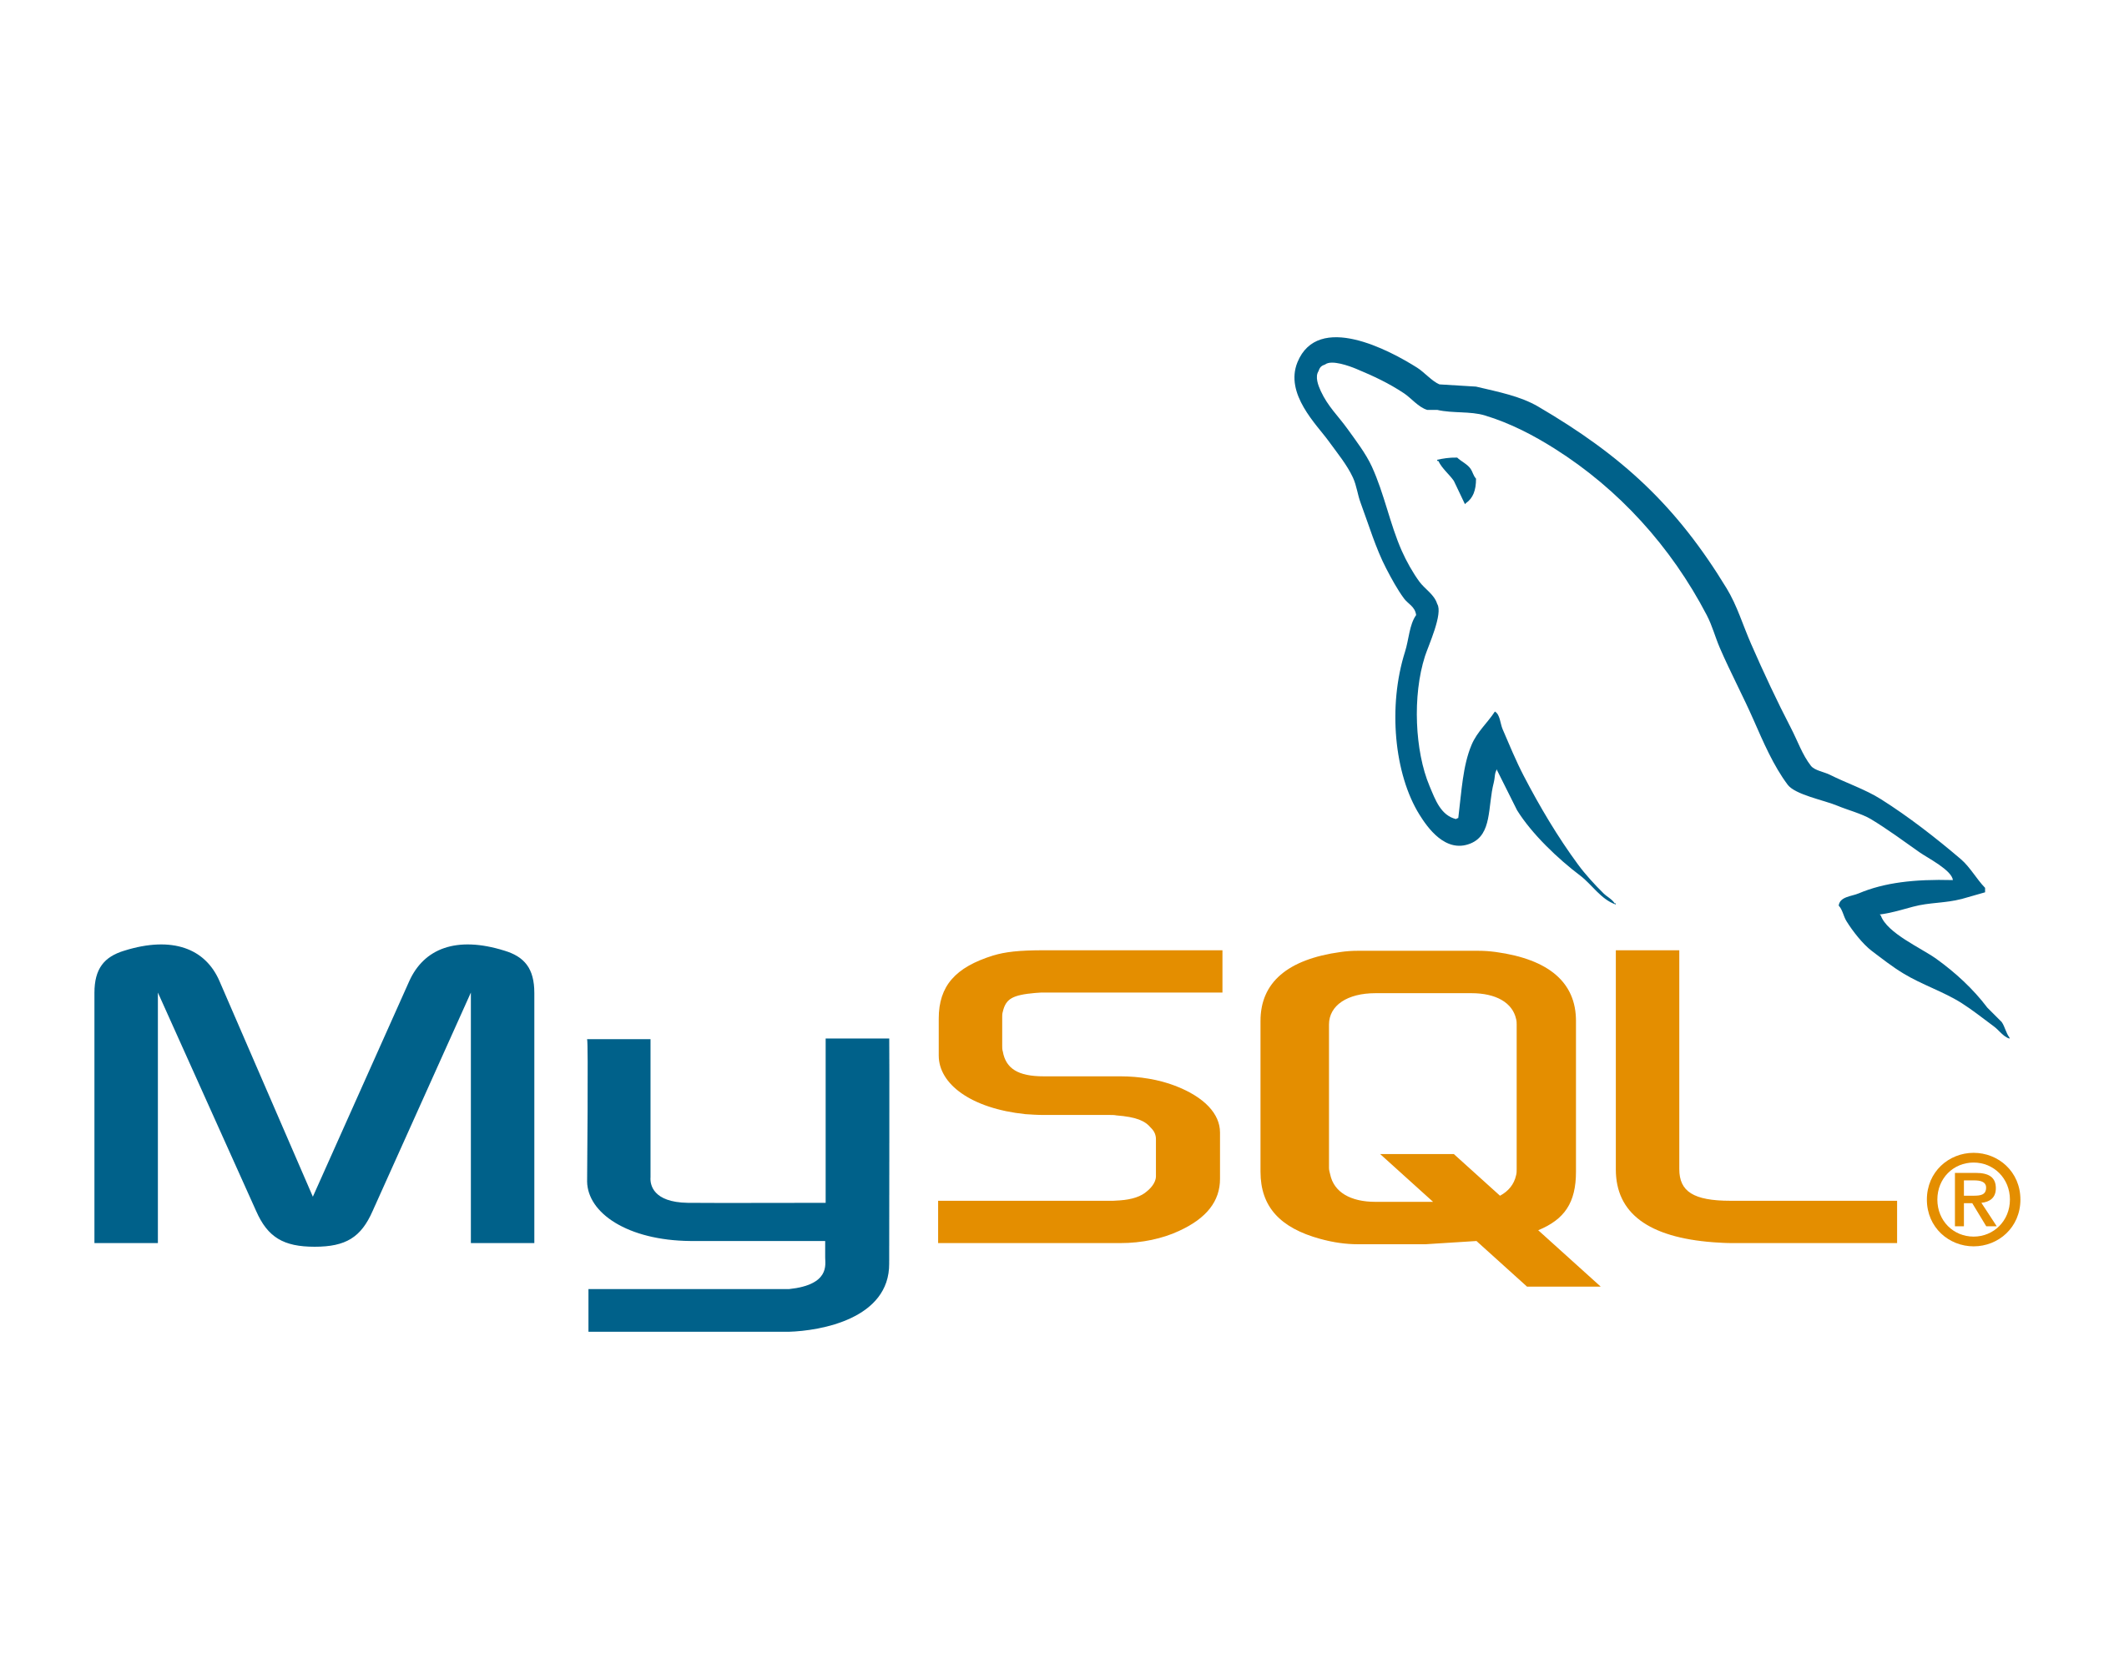
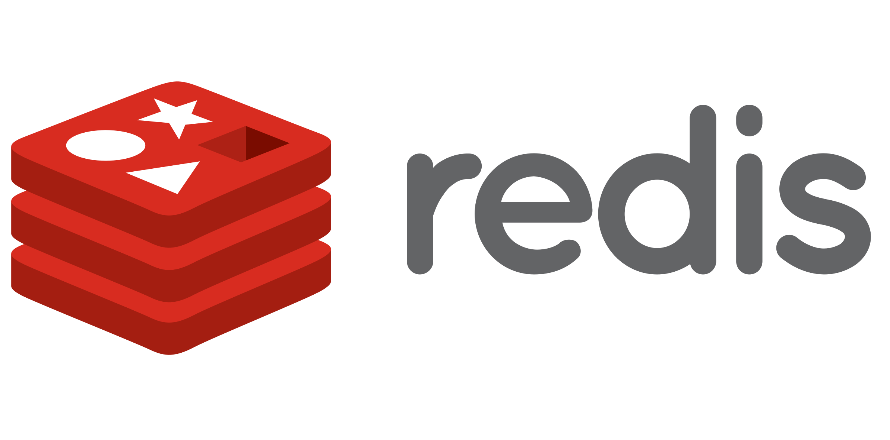
SQL and NoSQL

Slide 38

Summary
Web Application Designs
MPAs vs SPAs
Web Application Architectures
Monolith vs SOA vs Microservices
ASP.NET Core MVC vs Razor Pages
Repository Pattern
AutoMapper
Databases & ORMs
ORM vs Micro-ORM
SQL vs NoSQL
…
…
…

Slide 39
Questions?
Notes:
39

Slide 40










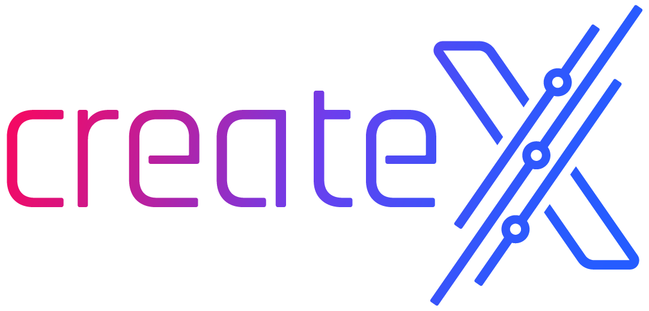


SoftUni Diamond Partners

Slide 41

Educational Partners

Slide 42
Trainings @ Software University (SoftUni)
Software University – High-Quality Education, Profession and Job for Software Developers
softuni.bg, softuni.org
Software University Foundation
softuni.foundation
Software University @ Facebook
facebook.com/SoftwareUniversity
Software University Forums
forum.softuni.bg
Notes:
42

Slide 43

License
This course (slides, examples, demos, exercises, homework, documents, videos and other assets) is copyrighted content
Unauthorized copy, reproduction or use is illegal
© SoftUni – https://softuni.org
© Software University – https://softuni.bg
Notes:
43

